Slide 1
1. How to use Trello to organize the work.
2. Art resources standards.
3. Reserved function/module for music.
4. Make sure the requirement you doing is the last version document.

Slide 2
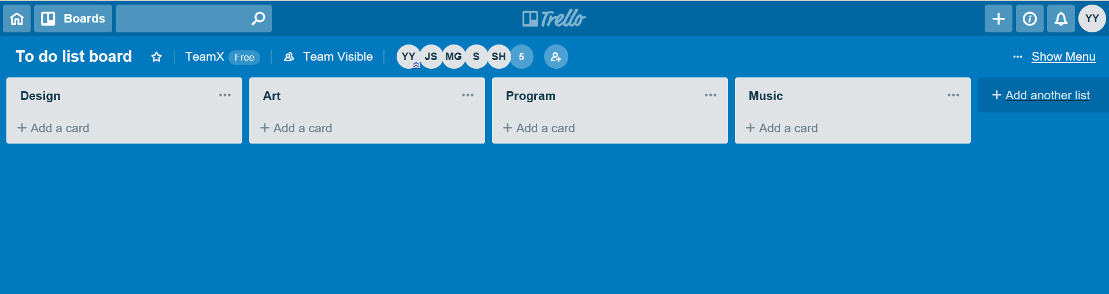
1. How to use Trello to organize the work.
Put your plan to the main board and I will organize and hand out.

Slide 3
2. Art resources standards.
Animation (frames)
Tag the name of the frame in same action.
Character
Special effects
Effect drawing
Environment & Interface
resources

Slide 4
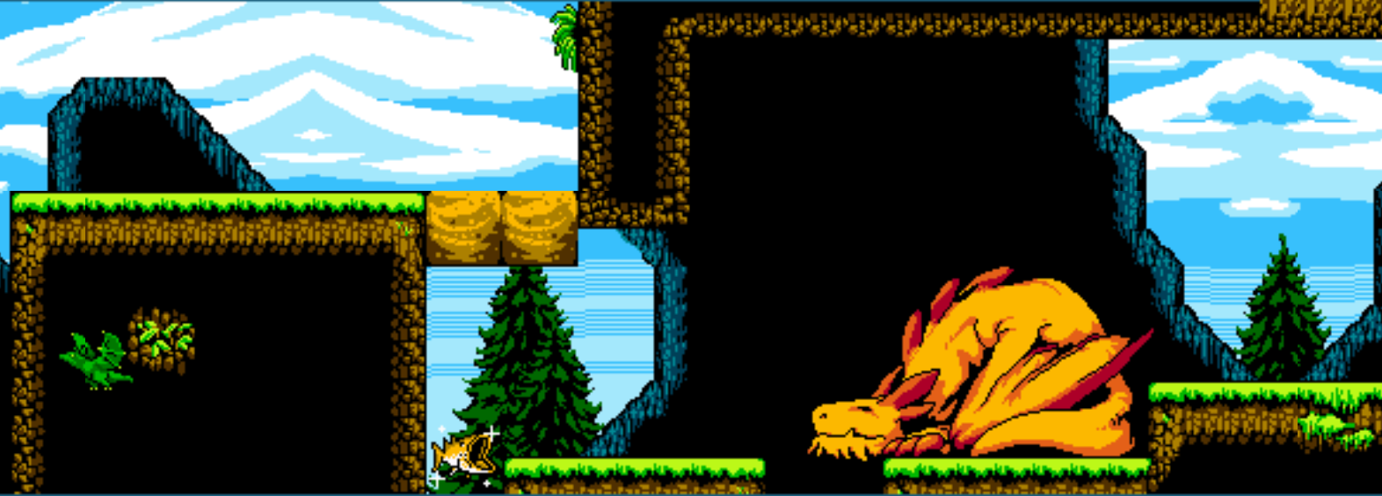


Slide 5
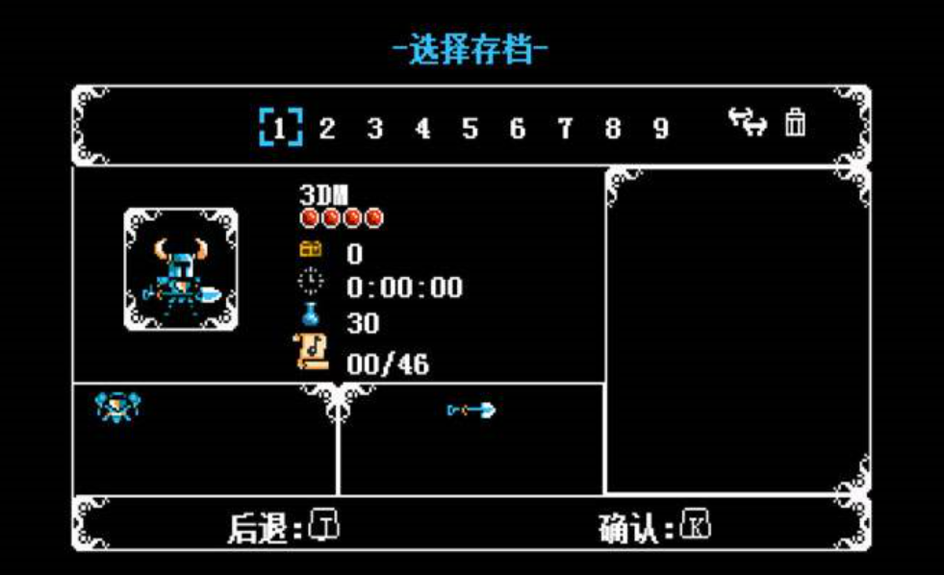


Slide 6
3. Reserved function/module for music.
Background music in main scene, it can be changed by some trigger.
For character each different action can be set sound, when character be hit can also make a sound.

Slide 7
Work day: 9:30-17:00
Don’t be late!

